Slide 1
ENG4118/5326 - Robotics 4/M Sensors, Actuators and Image capture, processing and analysis
Lecture 12
Kevin Worrall

Slide 2

Lecture Overview
Pneumatic System
Motors – Basic Principles
Brushed DC Motors
Speed Torque Graphs

Slide 3
Pneumatic System

Slide 4
Pneumatic System
Very similar to hydraulic systems
Pressurized air is used
Lower working pressures mean lower power-to-weight ratio
Air is compressible; hard to control
Simple, rugged, inexpensive, safe
Leakage is not a problem even in clean room.

Slide 5
Pneumatic System – Main Components
Compressor: Compressed air is generated by an electric motor driving
Filter: The air inlet to the compressor is filtered to remove particles
Silencer: to reduce noise levels
Pressure relief valve: is used to provide protection against abnormal pressure rises in the system
cooling system: compression increases air temperature, cooling is needed system is
filter and water trap: To remove water from condensation and contamination
air receiver: increases the volume of air and corrects small pressure fluctuations

Slide 6
Pneumatic System
Very similar to hydraulic systems
Pressurized air is used
Lower working pressures mean lower power-to-weight ratio
Air is compressible; hard to control
Simple, rugged, inexpensive, safe
Leakage is not a problem even in clean room.

Slide 7
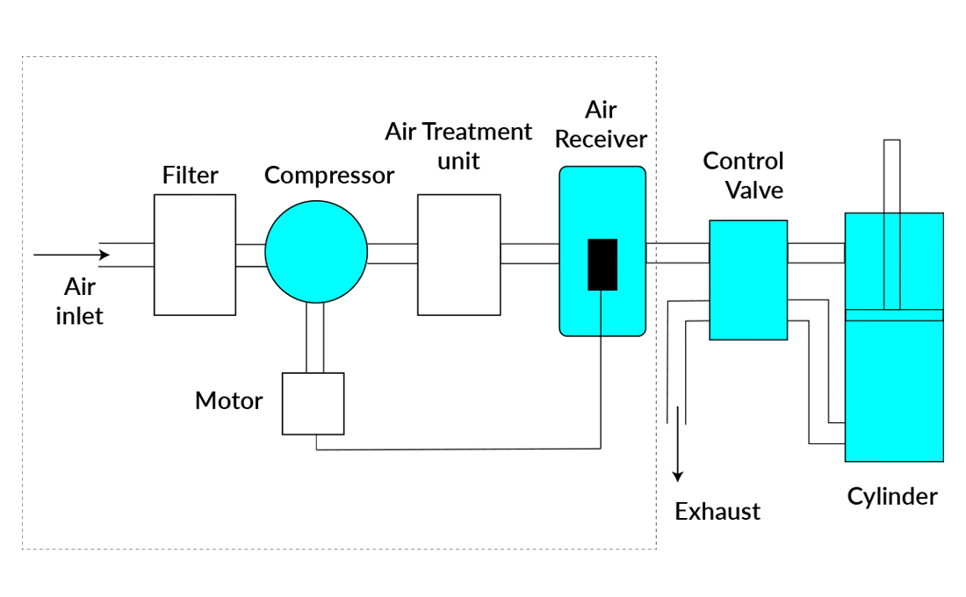
Pneumatic System

Slide 8
Pneumatic System
https://www.youtube.com/watch?v=lBARBZNLxQI

Slide 9
Pneumatic System
Advantages
Disadvantages
Cheap initial installation
Air availability
Ease of transfer through piping
Ease of power and speed transmission
Ease of maintenance, reliable components
Ease of use
Safe (from leaks and sparks)
Clean Compressed air can be stored
Usually off-the-shelf components
More energy cost compared to hydraulic
Requires bigger cylinder to handle the same load as in hydraulic
Deforms under load
Difficult position control
Speed control needs additional devices
Needs pressurized air cylinders
Easy to leak
Hard to find leaks
Noisy
Needs drying to avoid condensation
Does not work in extreme temperatures

Slide 10
Electric Motors

Slide 11
Electric Motors
Types of electric motors used in robotics
Brushed D.C. motors
Brushless D.C. motors
Stepper Motors
Permanent Magnet A.C. motors (PMAC)

Slide 12
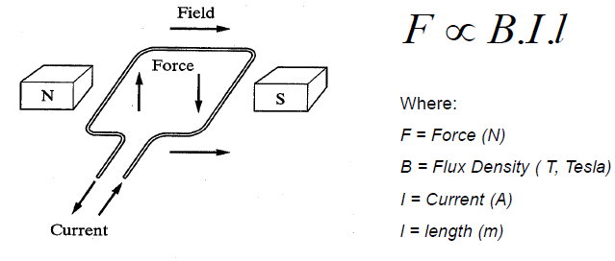
Electric Motors - Basic Principles
When a wire carrying a current is placed in a magnetic field it will experience a force normal to the plane formed by the magnetic field and the current (Faraday’s Law).

Slide 13
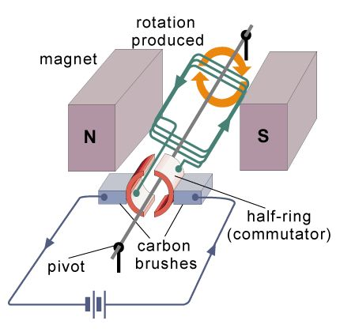
Electric Motors - Basic Principles
Each side of the coil experiences an equal force.
If the wire is attached to a shaft which is free to rotate, the resulting torque will produce a rotation of the shaft about an axis parallel to the shaft axis.
Changing the direction of the current or magnetic field results in a change in the direction of the applied force, allowing rotation to continue.
In practice:
Commutators and brushes are used to accomplish this change in current in brushed D.C. Motors
Electric switches are used for brushless D.C. motors
A.C. current is used for A.C. motors

Slide 14
Electric Motors - Basic Principles

Slide 15
Electric Motors - Basic Principles
https://www.youtube.com/watch?v=LAtPHANEfQo

Slide 16
Brushed DC Motors

Slide 17
Brushed D.C. Motors
Are very common in industry and have been used for a long time.
They are reliable, sturdy and relatively powerful.
The principle of operation is similar to the basic principle described with the stator (non-rotating part) composed of a set of fixed magnets with the rotor (rotating coil) carrying the current.
Conversely, if the rotor is rotated within the magnetic field, a current will develop in the coil and the motor acts as a generator.

Slide 18
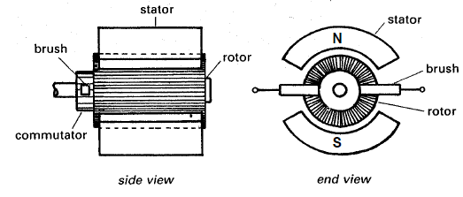
Brushed D.C. Motors
The commutators and brushes connect the rotor coil, at the maximum torque producing angle, to the external power supply.
This results in a current flow through the coil which feels a force because of the external magnetic field.

Slide 19

Brushed D.C. Motors
When permanent magnets are used to generate the magnetic field, the torque, T, acting on the coil is proportional to the magnetic flux, Φ, and the current, i, flowing in the rotor windings:
where kt is a constant and Kt is called the torque constant.
Since the magnetic flux is constant, output torque becomes a function of the current flowing through the coils

Slide 20
Brushed D.C. Motors
Additionally, because of the rotation of the coil within the magnetic field, electromagnetic induction occurs and results in the creation of a potential in a direction opposite to that of the motor power supply and this is termed the “back” emf.
The back emf, e, is proportional to the rate of change of magnetic flux which for a constant magnetic field is proportional to the angular speed, ω, of the rotor:
where k_{v} is a constant and K_{v} is called the electric constant for the motor.

Slide 21
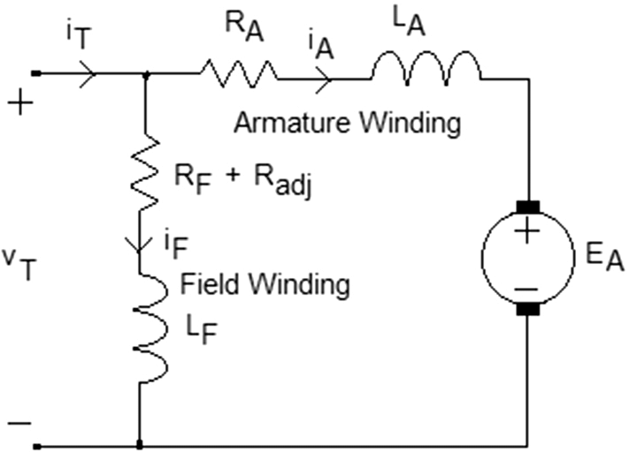
Brushed D.C. Motors
Equivalent circuit for a DC motor opposite
We represent the rotor coil as a resistor, R, in series with an inductor, L, and the back emf, e.

Slide 22


Brushed D.C. Motors
Neglecting the inductance of the rotor, then the potential across the motor is the applied voltage minus the back emf, v-e, applying Ohm’s Law:
The torque acting on the system can then be obtained as:

Slide 23
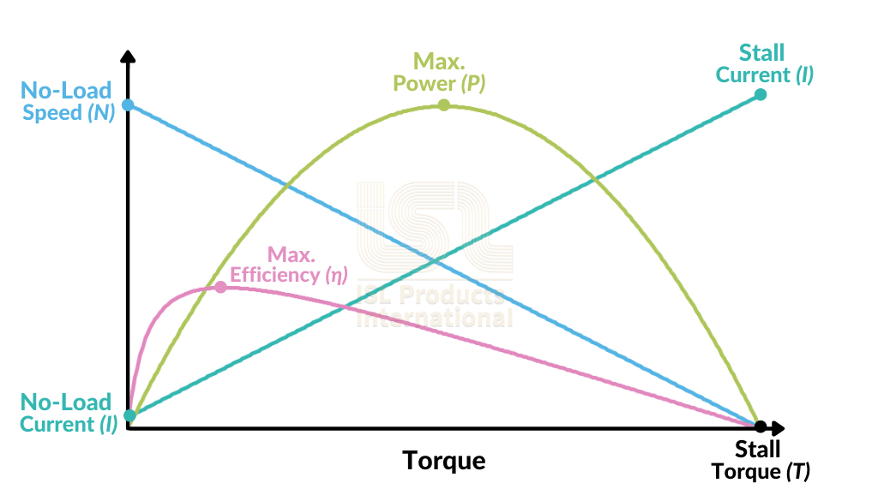
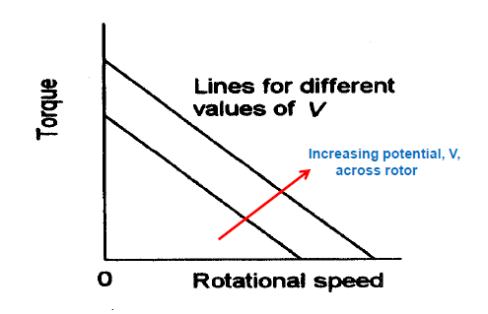
Speed Torque Graphs
Graphs of motor torque against rotational speed are a series of straight lines for different voltage values.

Slide 24

Speed Torque Graphs
The stall torque, at ω =0, can be obtained by putting in this angular speed value into the torque equation and is obtained as:
This stall torque is the maximum torque that the motor can supply but with no motor shaft rotation.
The motor reaches maximum speed (or no load speed) and no torque is applied to the motor shaft. The back emf equals the applied voltage and this is obtained as:

Slide 25
Brushed D.C. Motors
One major issue with brushed D.C. motors is the use of commutators and brushes to periodically reverse the current through the rotor coil.
Brushes make sliding contact with the commutator and consequently sparks jump between the two and they suffer wear.
Brushes have to be periodically changed and the commutator resurfaced.
To avoid these problems brushless motors have been designed.
These are a hybrid between A.C. and D.C. motors with construction similar to A.C. synchronous motors.

Slide 26
References
Niku, S.B. , Introduction to Robotics, 2nd Edition, Wiley, New Jersey, 2011
Bolton, W. , Mechatronics, 2nd Edition, Longman, New York, 2000
Maxon Motors website has a range of good information including calculation handbooks

